Slide 1

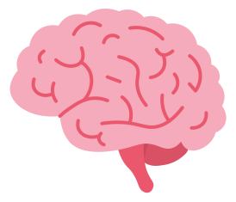
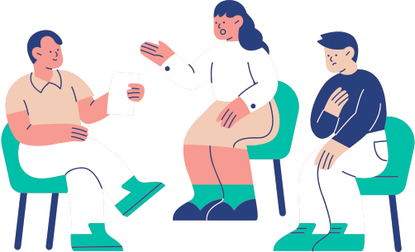


MindPulse
Self-awarness and tracking buddy for your mental health
Hackathon Oct 4 2025
Presentation By
Wasif Siddique, Jessel Solarte, Maria Marino

Slide 2







The Mental Health Challenge
1 in 5 adults experience mental health issues each year.
Most people don’t monitor their mood regularly.
Lack of early tracking = delayed intervention.
Current apps are focus on diagnostic, they collect data but don’t provide actionable insights and support from humans.

Slide 3




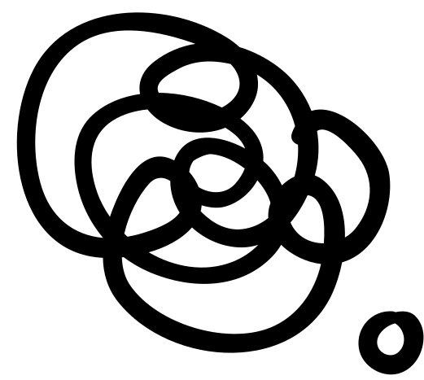
Why MindPulse?
People struggle to keep track of their mental health journey.
Consistency
Awareness
Prevention
Recovery
Impact
MindPulse exists to help people before it’s too late.

Slide 4






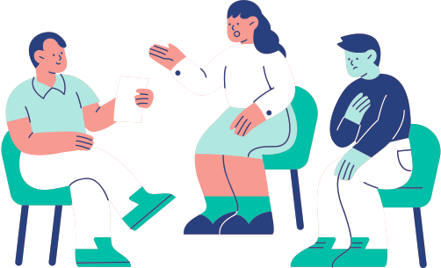
Target Users
Primary Users:
Secondary Users
Key Insigtht
Anyone who wants to track their mental health daily.
Individuals diagnosed with or experiencing stress, anxiety, or mild depression.
People open to using apps for self-improvement and early intervention.
Healthcare providers (doctors, psychologists, therapists).
Our app is not diagnostic, it’s a support tool to enhance awareness, provide actionable insights, and complement professional care.

Slide 5


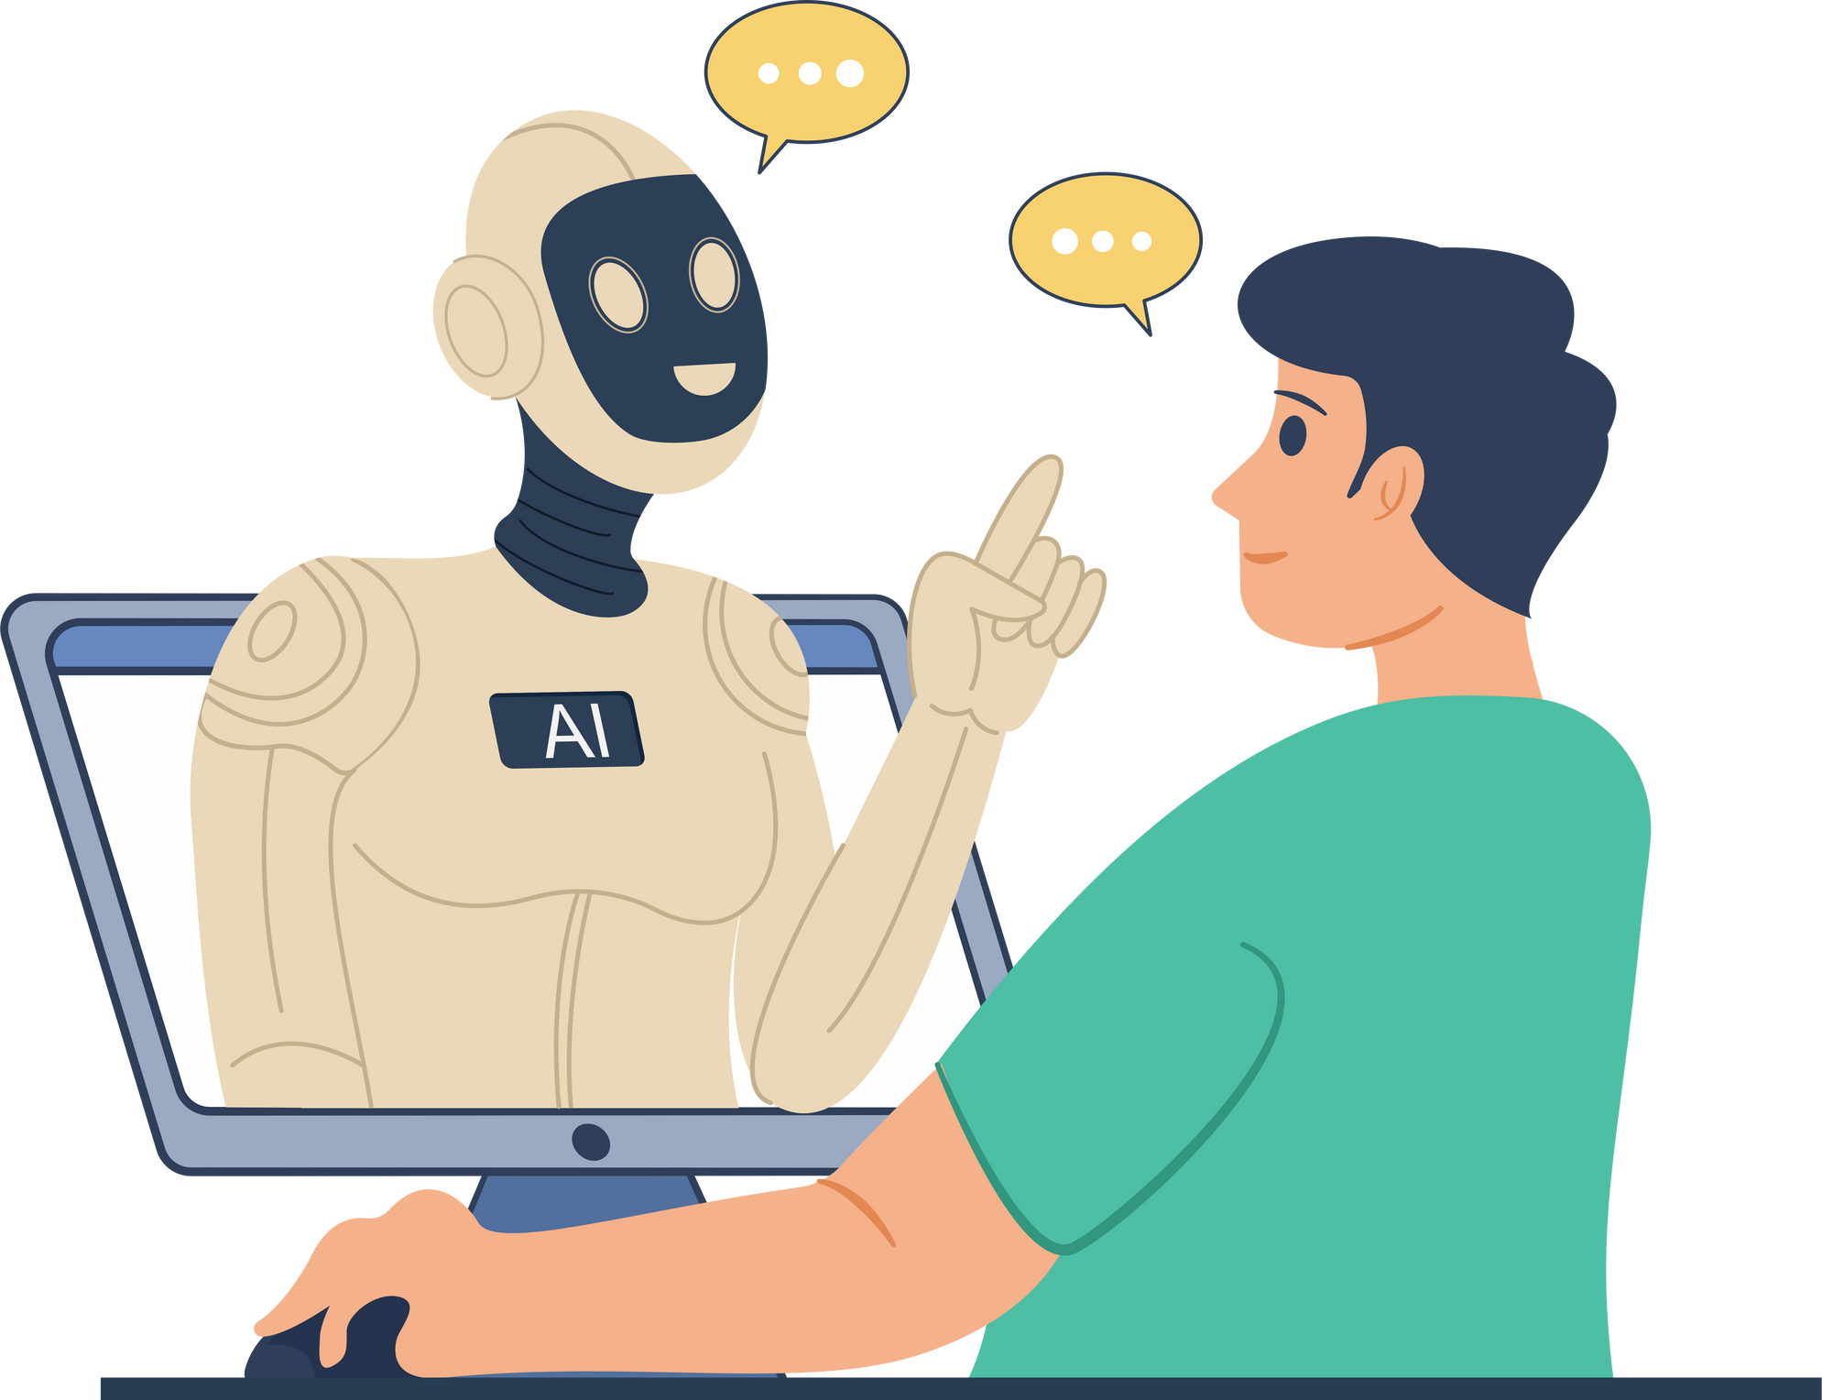

Our AI - Powered Solution
Pattern Detection:
Risk Alerts:
Detects emotional patterns and triggers from user input
Assigns risk levels and sends early alerts to mental health professionals
Personalized Guidance:
Suggests actions like breathing exercises, workouts, or reminders

Slide 6

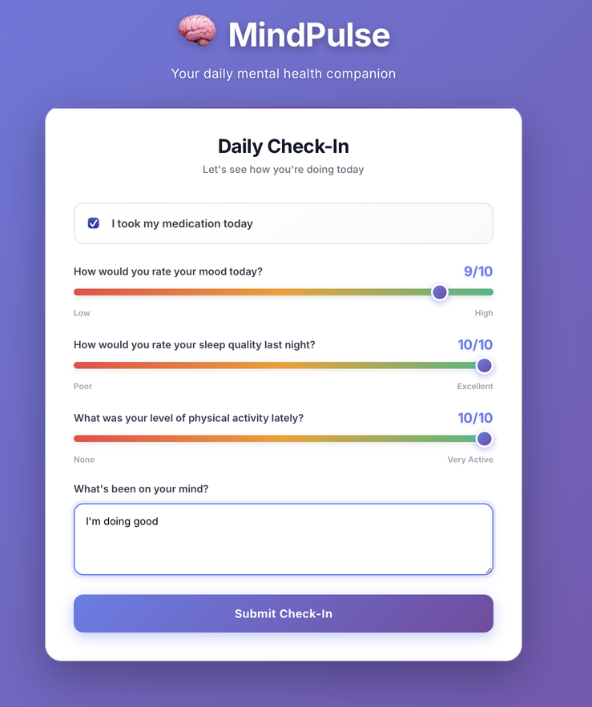

High Level Design
Survey page collects ratings based on user input
Input is sent to claude for analysis
Claude responds back with risk level, current analysis and contacts provider if deemed necessary

Slide 7
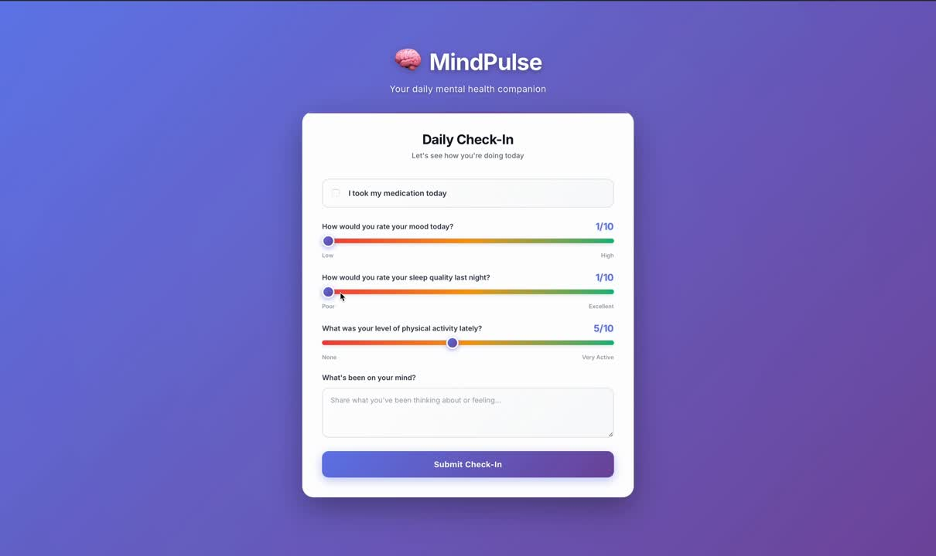
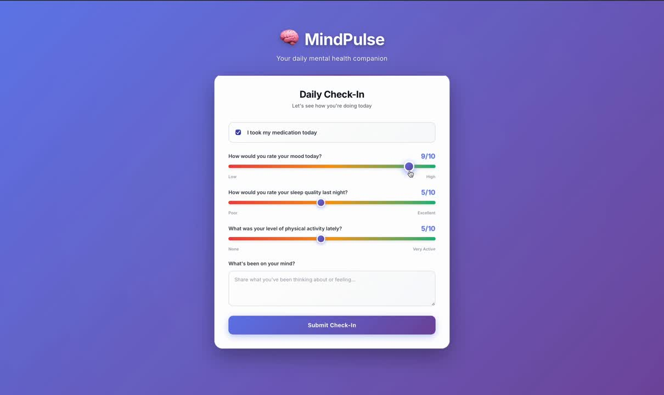
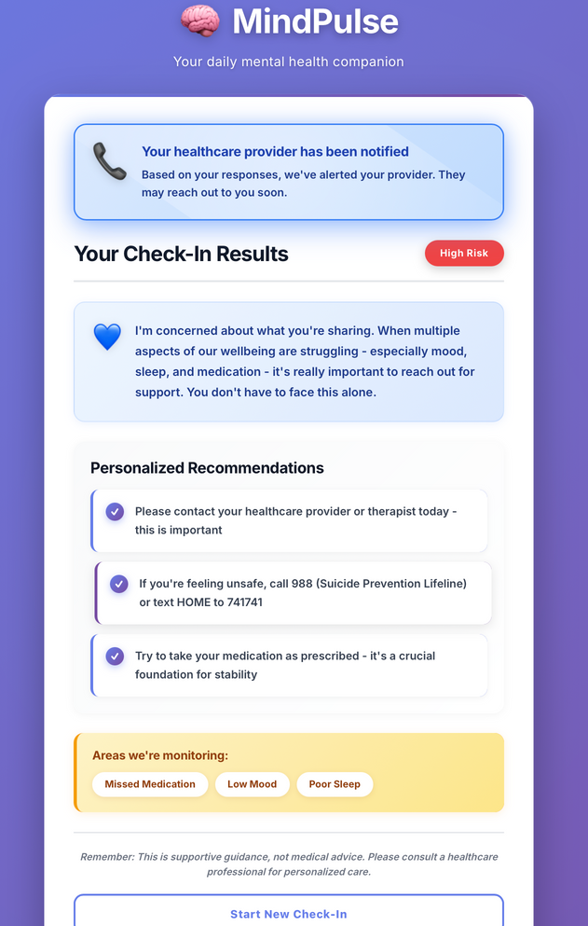
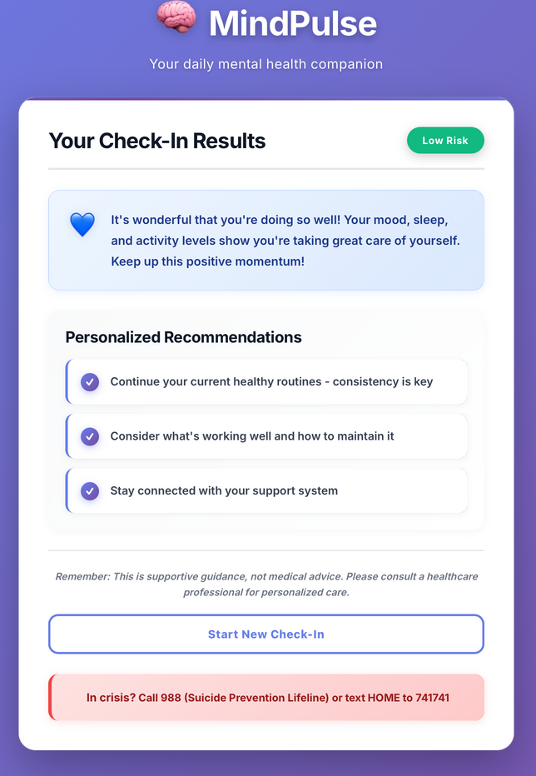
Results
FRONT END WEB APP
LOW RISK SCENARIO
HIGH RISK SCENARIO

Slide 8

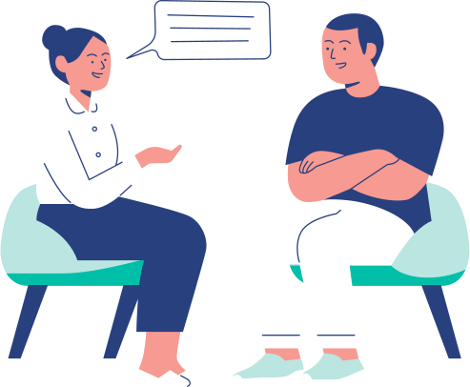

Human-in-the-Loop
Reviews critical alerts for accuracy and urgency.
Adjusts recommendations and follow-up plans.
Provides on time contact to professional intervention.

Slide 9



From Idea to Prototype: The Making of Mind Pulse
01
Inspiration
02
Concept and design
Identified the need for a daily, compassionate mental-health tracking tool.
Defined user flow
(input → AI → feedback → alert)
AI integration
HITL
03
04
Used Claude API for emotion analysis and advice generation based on text input. Implemented web app using Typescript-React and claude agent with python.
Human experts review sensitive cases, offering understanding and guidance where AI alone cannot.

Slide 10



Thank You!

